Slide 1

Singing Lesson 2
By Free Knowledge Mission

Slide 2
Agenda
Ways we Learn | What is a Vibrato
Proper Health | Warm Ups
Where are my Vocal Chords | Mixed Voice
Find your voice | Chest Voice
Voice type | Stage Fright
Diaphragmatic Support | Continued Lessons

Slide 3
Ways to Learn
Learn on your own through YouTube
Learn one or many methods
Be careful not to damage your vocal chords by getting carried away or practicing improper technique
Find a coaching styles $50 - $150 an hour
Ken Tamplin – Open throat technique – 90 video playlist – Talk about my top ten
SLS – Speech Level singing
Most Importantly – Perfect practice make habit

Slide 4
Steps in Learning
Unconscious Incompetent – I don’t know what I’m doing and I don’t know where I’m going
Conscious Incompetent – I know what I want but I still can’t do it.
Conscious Competent – I know what I want and with practice I know how to get there.
Unconscious Competent – I know what I want and it’s second nature.

Slide 5
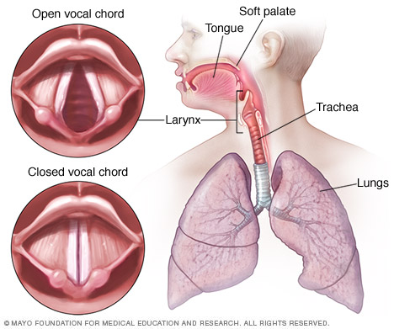
Where are my Vocal Chords?

Slide 6
Find Your Voice
Start with a artist in your range as an influence.
Build from pieces from everyone to add to your own unique style

Slide 7
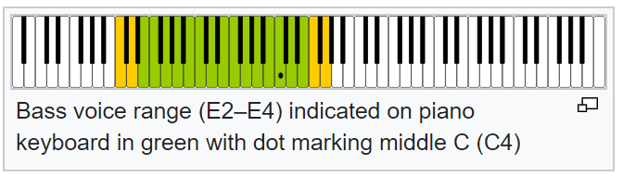
Voice Type
Female
Soprano
Mezzo-Soprano
Contralto
Men
Countertenor
Tenor
Baritone
Bass
Children
Treble

Slide 8
Proper Health - Nutrition
Prevent a Cold or Flu – Mucus on the vocal chords
Zinc Lozenges – Emergen C
Vitamin C Chewable
Probiotics
Raw Garlic – On Toast
Ginger – Tea
Multi-Vitamin
Vitamin D-3

Slide 9
Diaphragmatic Support
Most important component of singing
You Lose 30 breath support percent by sitting
Diaphragm is at the bottom of your ribs
Abdominal cavity goes in and out

Slide 10
What is Vibrato
State of Oscillation in your vocal cords – Start slow and speeds up and then resonances takes over
Variation of a note or Signature of a note
Can go up or down a semi-tone
Types
Diaphragmatic vibrato
A Vocal Trill vibrato
The Laryngeal vibrato
Caprino vibrato
A "Tremolo" vibrato
A "Natural" vibrato

Slide 11
Warm Up
Practice a chord with on "AH” to open our throat
"AH!" Like the Doctor wants to see our tonsils.
Migrate up the scale, or ascending a passage, in this case, a scale. "Lah, ah, ah, AH, ah, ah, ahhhh…"

Slide 12
Mixed Voice
There is an area in the voice that has a passageway between our Chest/Call/Belting Register that connects this register with our Falsetto.
This area is called the Passaggio (or passageway from our chest / call register into our falsetto register).
Think of this like a leg or an arm. If we're going to kick a soccer ball, we employ the strength of our quad from the upper part of our leg and our calf from the lower part of our leg, however: we have a knee that connect the two. This knee is our "Passaggio."

Slide 13
Chest Voice
The foundation of singing – This is where you start building the foundation like a house before you add rooms to your house.
Belting voice if you were shouting as someone.

Slide 14
Stage Fright
Fears – Is this hurt me or embarrass me?
What if everyone hates me?
What if I forget the lyrics?
What if I can hit the high note?
What if my voice cracks?
What if no one shows up?
Everyone wants to see you succeed. They’re there to watch you and there for entertainment.
You’ll have many times to practice and get more confident then it becomes second nature.

Slide 15
More to Cover
Head voice exercises
Cracking or Croaking
Sing without Tension
Open Throat
Nasal Voice
Increase vocal range

Slide 16
References
Ken Tamplin

